Slide 1


Simulating photonic devices using finite-difference time-domain method
Shivi Gupta SURGE roll no. 2030078 Department of Electrical Engineering, Indian Institute of Technology, Kanpur

Slide 2
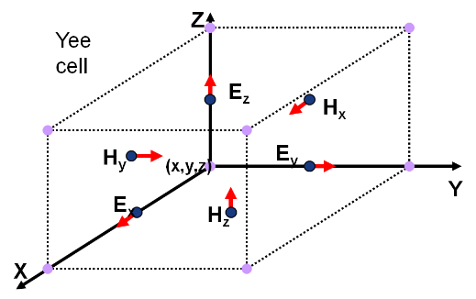
Objective of the project
FDTD method divides a simulation region into cells to solve for EM field-propagation through photonic devices.
The objective of the project is to set up optical simulations using Lumerical FDTD, an electromagnetic solver.
Plotting Transmittance, reflectance and bandstructures using simulations.
Comparing results obtained with theoretical plots.
Picture taken from https://support.lumerical.com/hc/en-us/articles/360034914633-Finite-Difference-Time-Domain-FDTD-solver-introduction

Slide 3
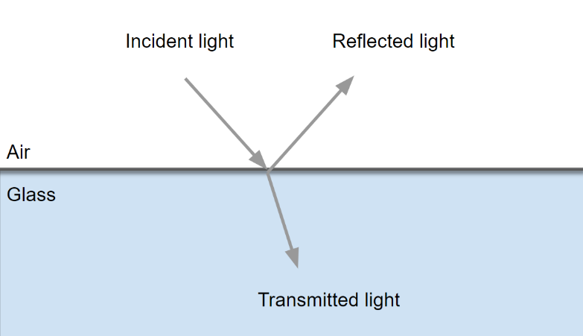
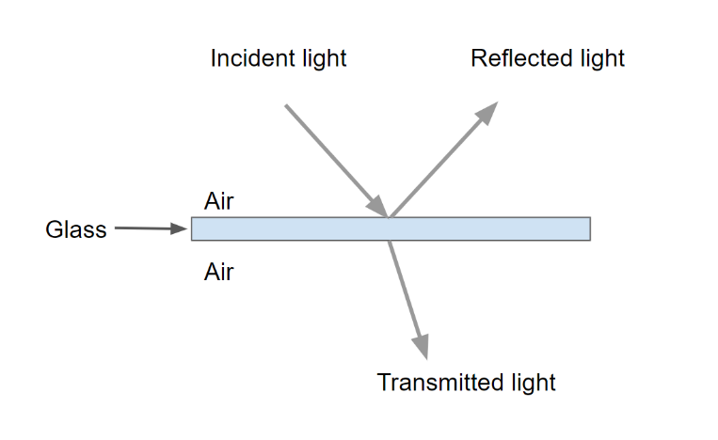
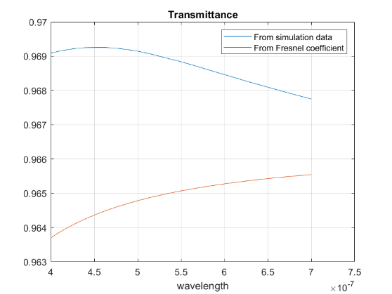
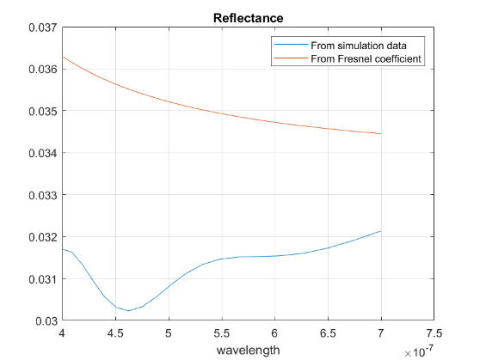
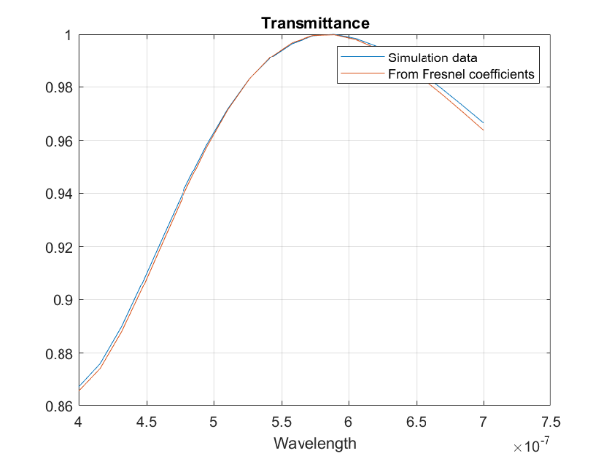
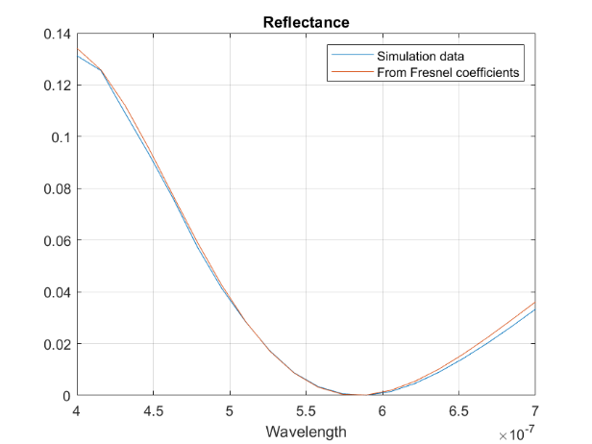
Light incident on glass surface
Light incident on a thin layer of glass
T and R plots for normal incidence
T and R plots for normal incidence

Slide 4
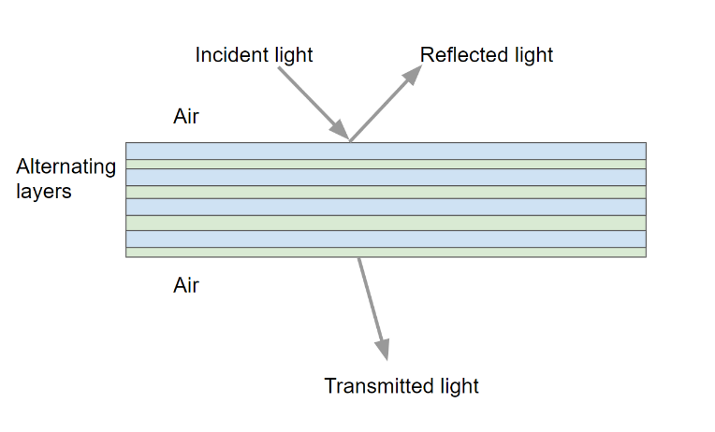
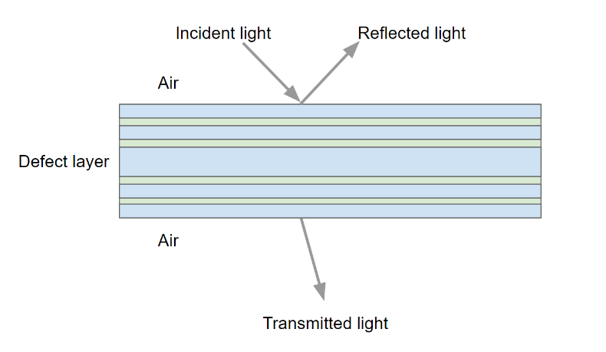
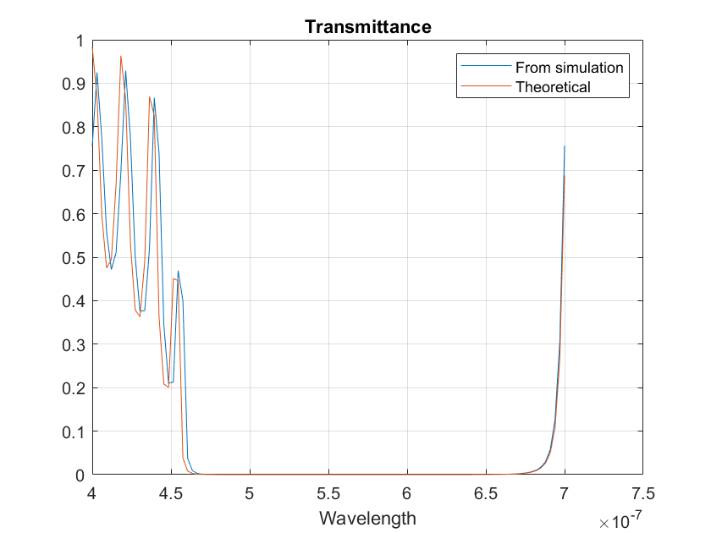
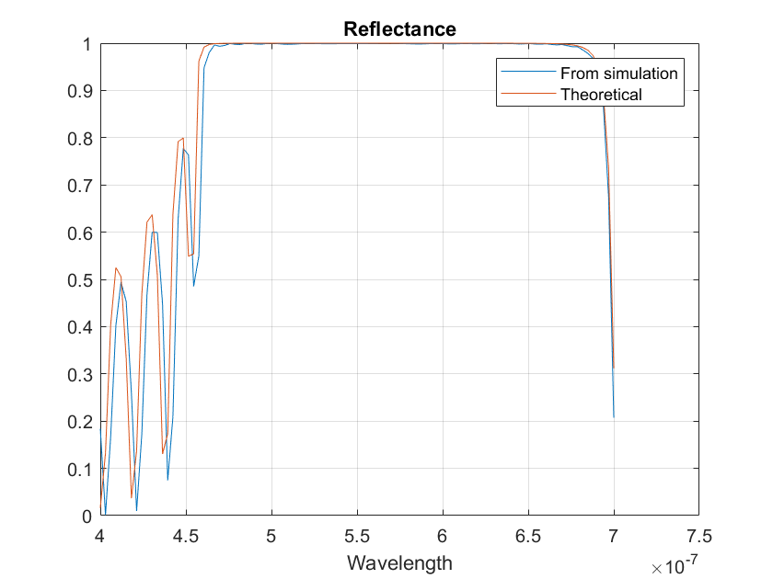
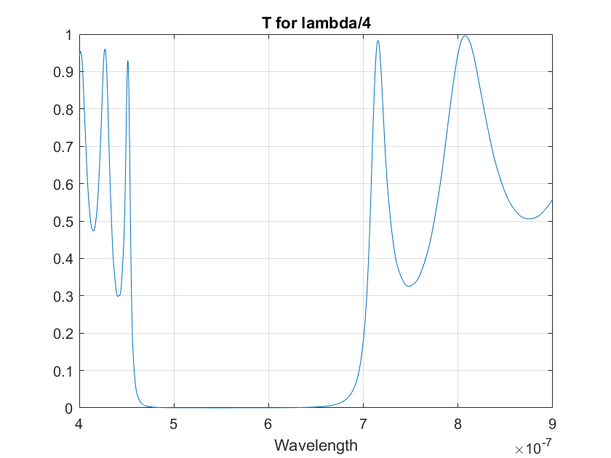
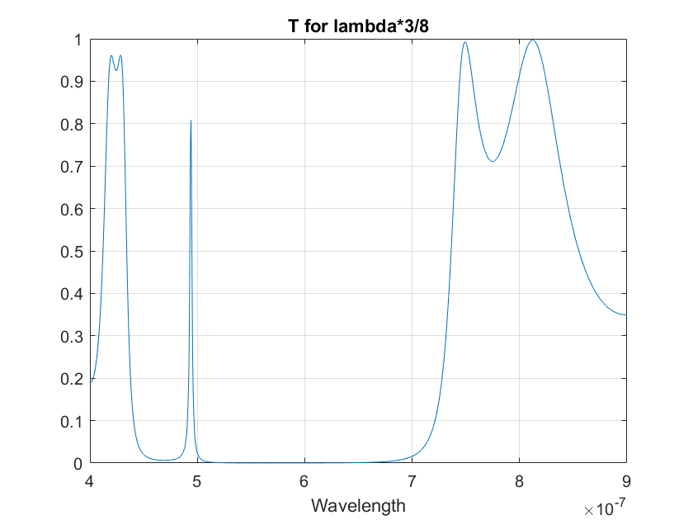
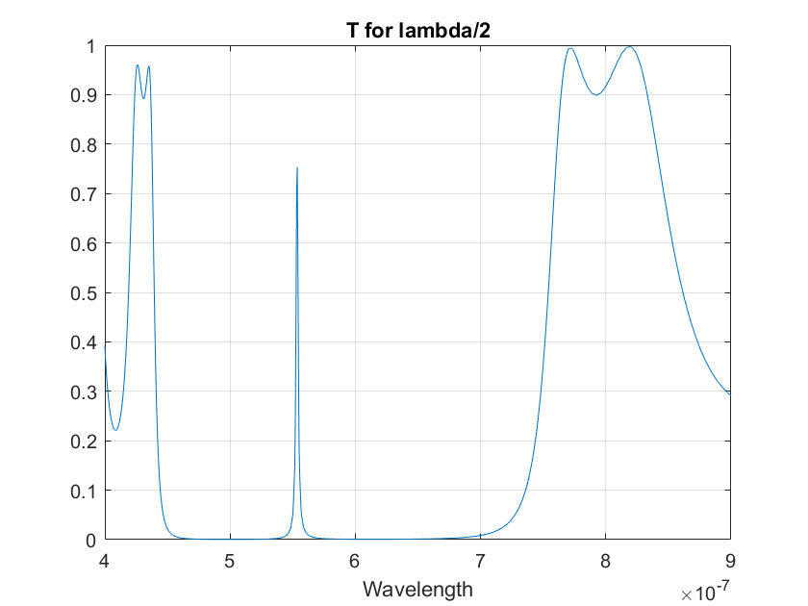
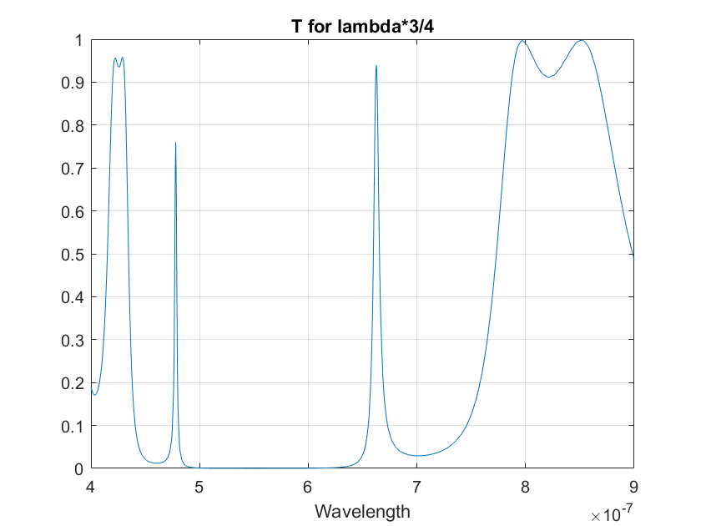
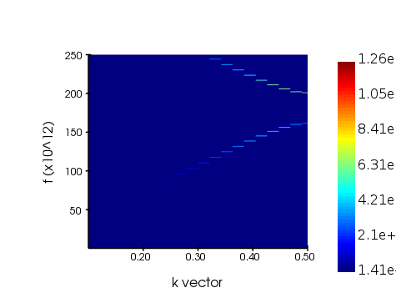
Light incident on a photonic crystal
Light incident on a photonic crystal with a defect
T and R plots for 20 layers
T plots with increasing thickness of defect layer
Bandstructure diagram

Slide 5
summary
Started with a simulation for light incident on an air-glass interface.
Then simulated a thin glass layer of thickness ~100 nm.
Finally simulated a 1D photonic crystal consisting of same alternating layers.
Studied the effect of having a defect in a photonic crystal.
Comparing with theoretical plots, errors are quite small but there’s still room for improvement.

